Slide 1
www.car-maniacs.co.uk
An awesome car rating website
by mustached-ninja

Slide 2
What is it?
A simple website
People can rate cars
Star-based system
Browse cars by rating

Slide 3
Stand Out Features
Simple
Easy to use
No need to register
Unbiased
Ethics Statement
Transparency

Slide 4
User Personas
Owner
Visitor
Browse cars (4/5)
Rate that car (5/5)
Compare their car to others (2/5)
Browse cars (5/5)
See ratings (5/5)
Compare those ratings (5/5)
See ranking (5/5)
Administrator
Reviews ratings
Deletes malicious ratings
Manages ads and price engine

Slide 5
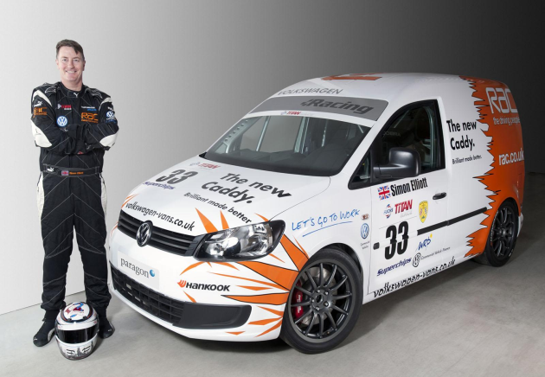

Personas
Alex, has a big crush on cars
I have always been passionate about cars. I chose to become a mechanical engineer just because I wanted to know intimate details about how the car works. I need an website were I could find exciting news about the cars/car manufacturers.
Dean, father of two
I need a platform that could help me find a suitable car. I am currently commuting from Glasgow to Stirling. I need a reasonably-priced car which does not consume a lot of fuel. I would really appreciate a comparing facility to help me make up my mind faster, I already have a shortlist.

Slide 6
Must Have
Database about cars
Ratings
Ranking bar (best)
Browsing
Comparing cars

Slide 7
Should Have
Comments (text)
Searchable comments
Search bar
Users

Slide 8
Could Have
Price engine provided by a 3rd party
Car of the Month
E.g. most visited
Ads?
From companies that aren’t car manufacturers
No way to purchase biased reviews

Slide 9
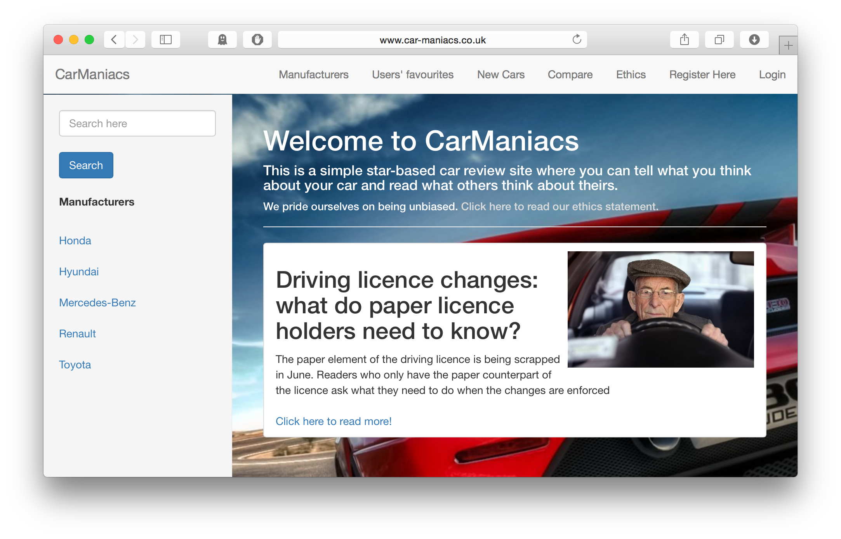
Main Screen
Search Bar
List of manufacturers
Pictures, news

Slide 10
Won’t Have
A fancy UI for administrators

Slide 11
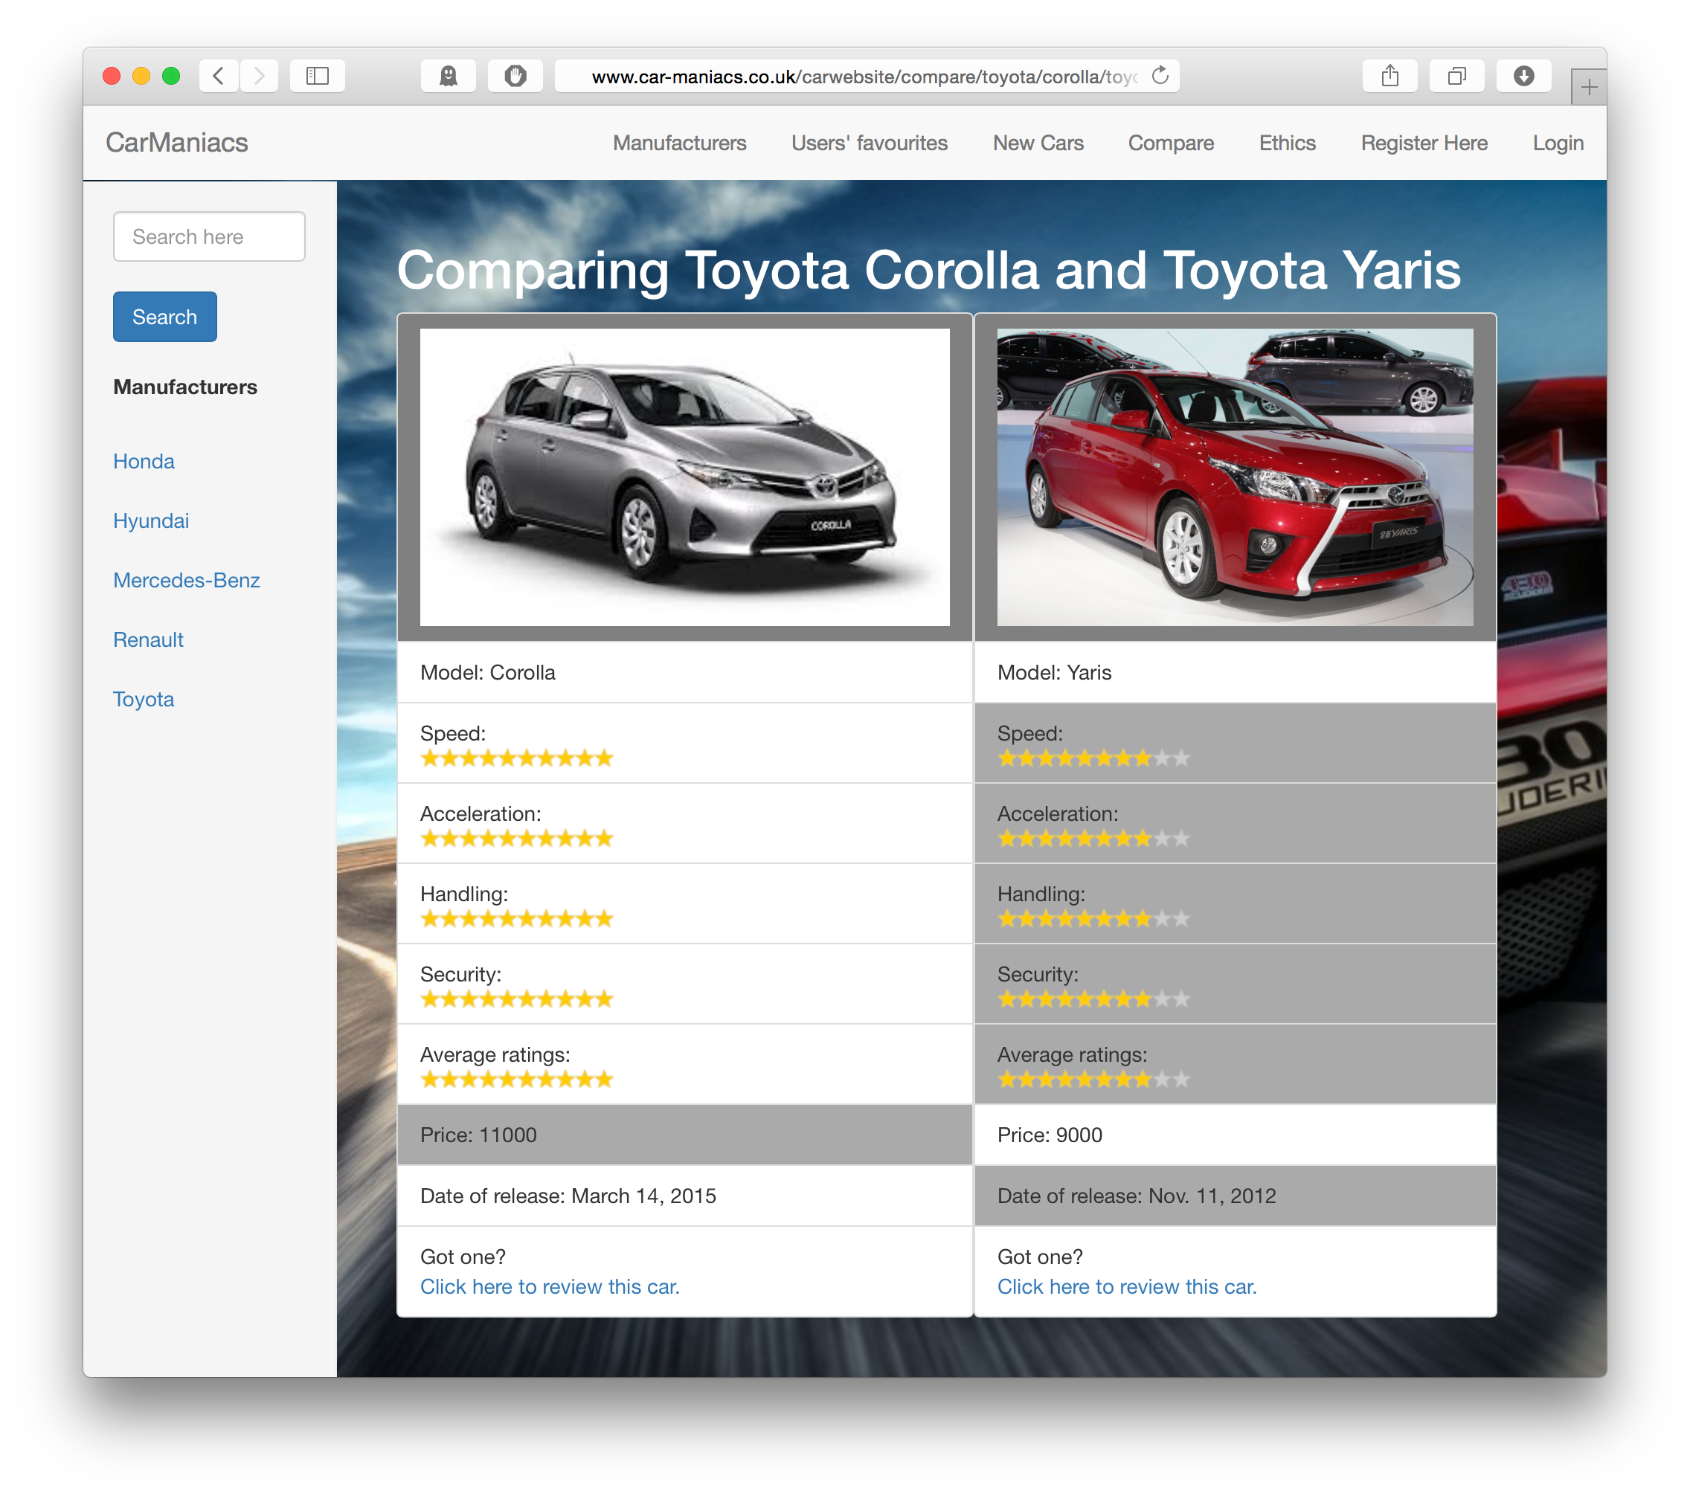
Compare
Easy
Relevant fields next to each other
See which is better

Slide 12
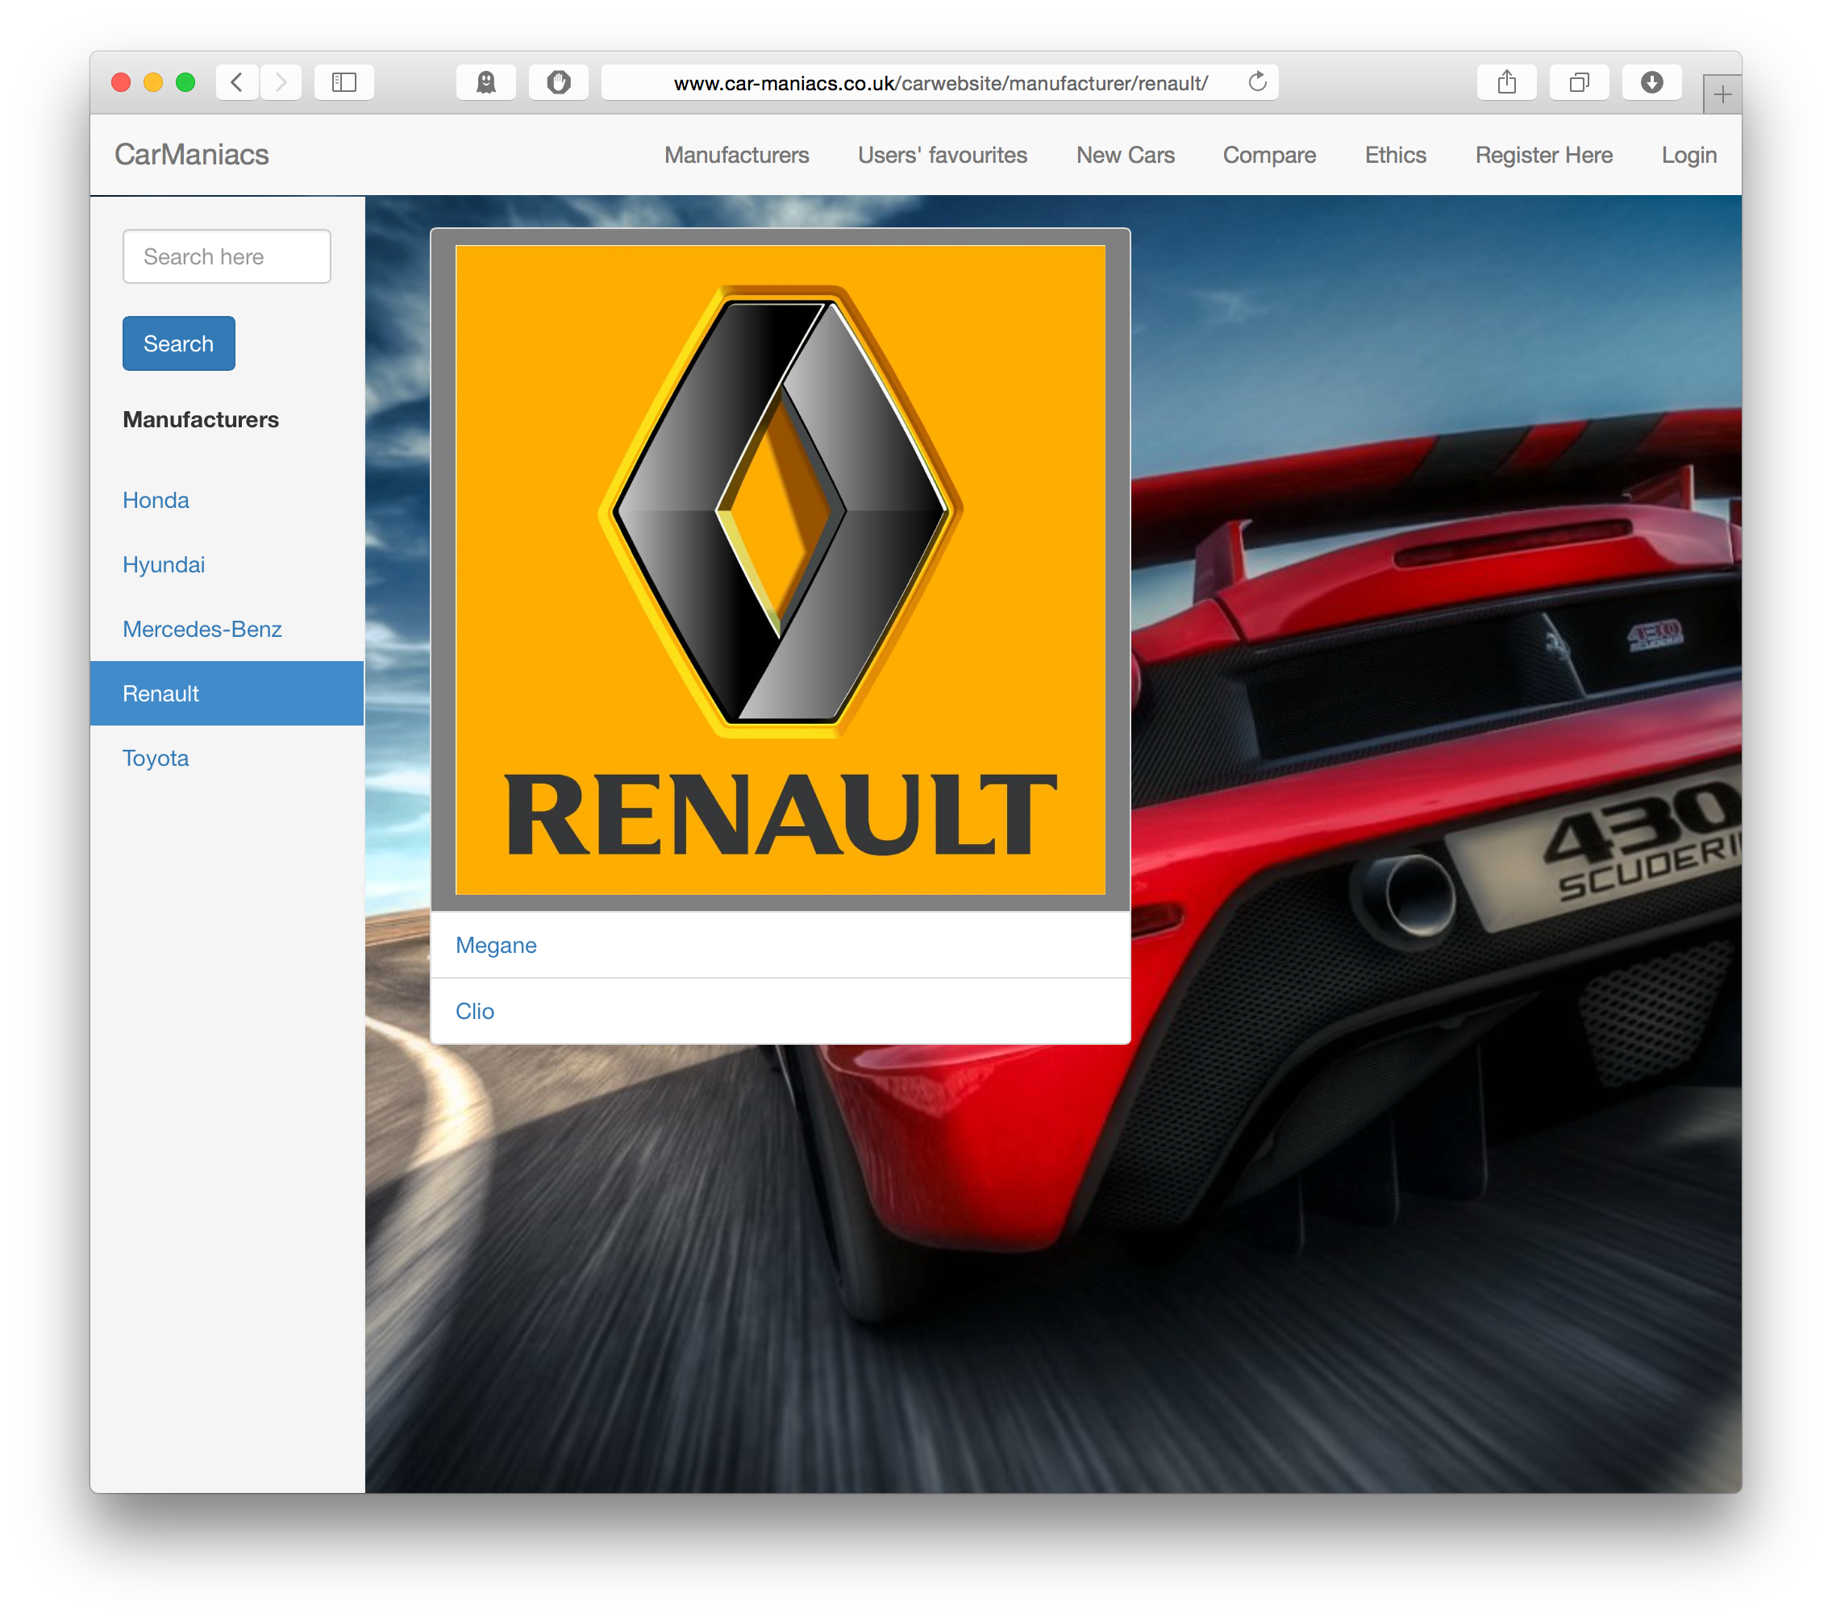
Manufacturer
List of models
Clickable

Slide 13
3-tier Architecture
URL
params
SQL
queries
Clicking
HTML/CSS/JS
Web browser on a desktop or mobile
e.g. Chrome, Safari
Client
Application Server built using
Django 1.7
Middleware
SQLite
Database
Visual
HTML
CSS
Results
User

Slide 14


Home
Browse
Top Rated
New Cars
Ethics Statement
Brand
Results
List of Cars
List of Cars
Model
Results
Car Profile
Rate
Compare

Slide 15
Domain Design
/compare/toyota/corolla/honda/civic
/search
/accounts
/admin
/
/manufacturer/toyota/corolla
/rate/toyota/corolla
GET and POST too
/top_rated
/new_cars

Slide 16
ER Diagram
1
Users
written by
N
Reviews
N
is about
Manufacturer
1
N
Model
News
1

Slide 17
Model
Field | Type
manufacturer | ForeignKey(Manufacturer)
title | CharField
averageRatings | FloatField
speed | PositiveIntegerField
acceleration | PositiveIntegerField
handling | PositiveIntegerField
security | PositiveIntegerField
dateOfRelease | DateField
price | PositiveIntegerField
slug | SlugField
picture | ImageField

Slide 18
Review
Field | Type
reviewer | ForeignKey(User)
model | ForeignKey(Model)
speed | PositiveIntegerField
acceleration | PositiveIntegerField
handling | PositiveIntegerField
security | PositiveIntegerField

Slide 19
News
Field | Type
intro | CharField
title | CharField
link | CharField
show | BooleanField
slug | SlugField
picture | ImageField

Slide 20
Manufacturer
Field | Type
name | CharField
slug | SlugField
picture | ImageField

Slide 21
github.com/akoss/mustached-ninja

